Slide 1

Form 28
SIR Monthly Cash Report
February 6, 2025
SIRinc.org for member info
WeAreSir.com for the public

Slide 2
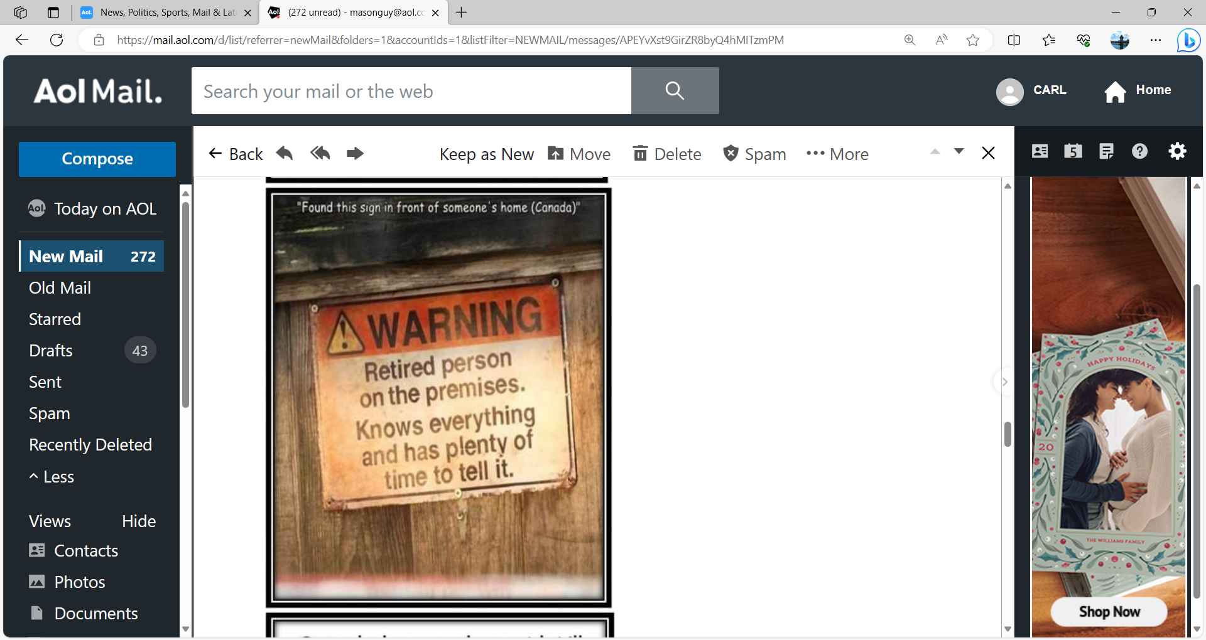

Slide 3
How Important is the Form 29
to Your Branch?

Slide 4
What do We Do with the Data from Your Form 28?
Prepare Taxes
IRS
State
Register
Secretary of State
State Auditor General

Slide 5

Legal Requirement to Be a Corporation
Tax Authorities
Federal IRS
IRS Form 990, 990EZ, 990N
State FTB
FTB Form 199

Slide 6
Legal Requirement to Be a Corporation
Registration
Secretary of State
SI-100
State Auditor General
RR1
CT-TR1

Slide 7
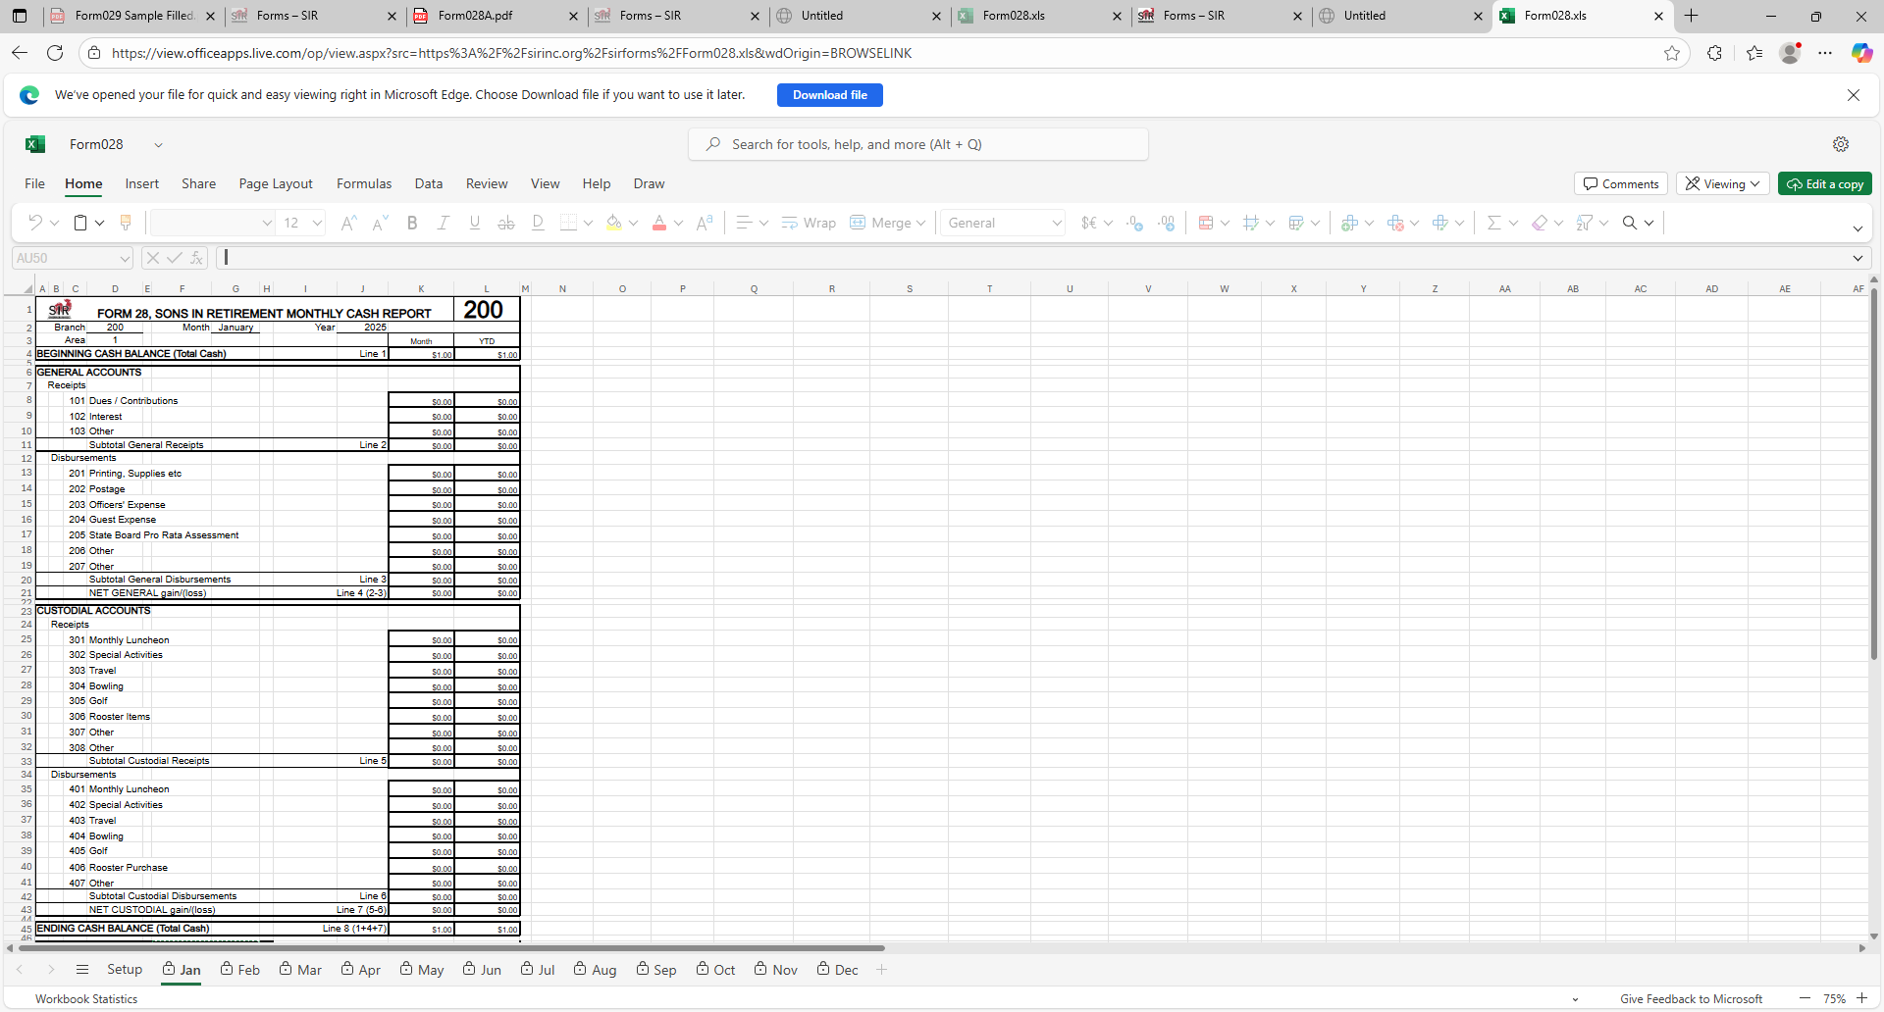


Slide 10
General funds: Money that are part of doing business in the branch

Slide 11
Custodial Funds. These are money that passes through the branch from a member to be paid out on behalf of that member such as luncheon fees

Slide 12
Cash Elements and Membership
Used buy SIR State:
Monitor the Health of the Branch
Calculate the Assessments for the Year (Oct of Past Year)

Slide 13

Questions?

Slide 14


Slide 15
Form 29
Branch Audit Report
February 6, 2026
SIRinc.org for member info
WeAreSir.com for the public

Slide 16
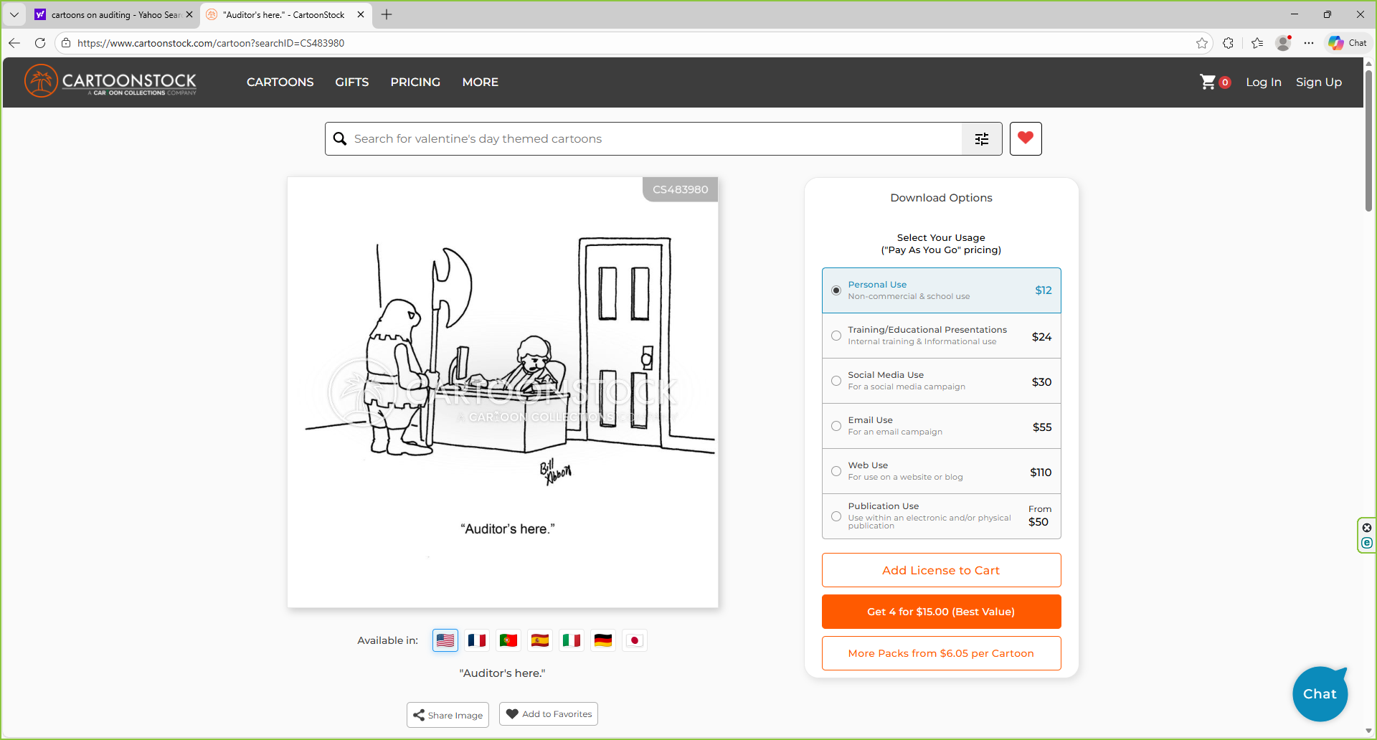

Slide 17
Why Do We Do Audits?
Compliance Assessment
Fraud Detection and Prevention
Required by government agencies to support
our Not-for-Profit Status
Increase Trust

Slide 18
What Can the Big Sir Due to Help the Audit?
Participate in Selecting The Audit Committee
Emphasize the Importance of the Audit
Review audit Report, implement Recommendations

Slide 19
Steps in Doing an Audit?
1. Select an Audit Committee
2. Obtain Assess to Financial Records & Documents
3. Verify Bank Reconciliations were Done and Cash is Correct
4. Select samples of Transaction and do substantive testing
5. Summarize Finding and Prepare Form 29 Audit Report

Slide 20
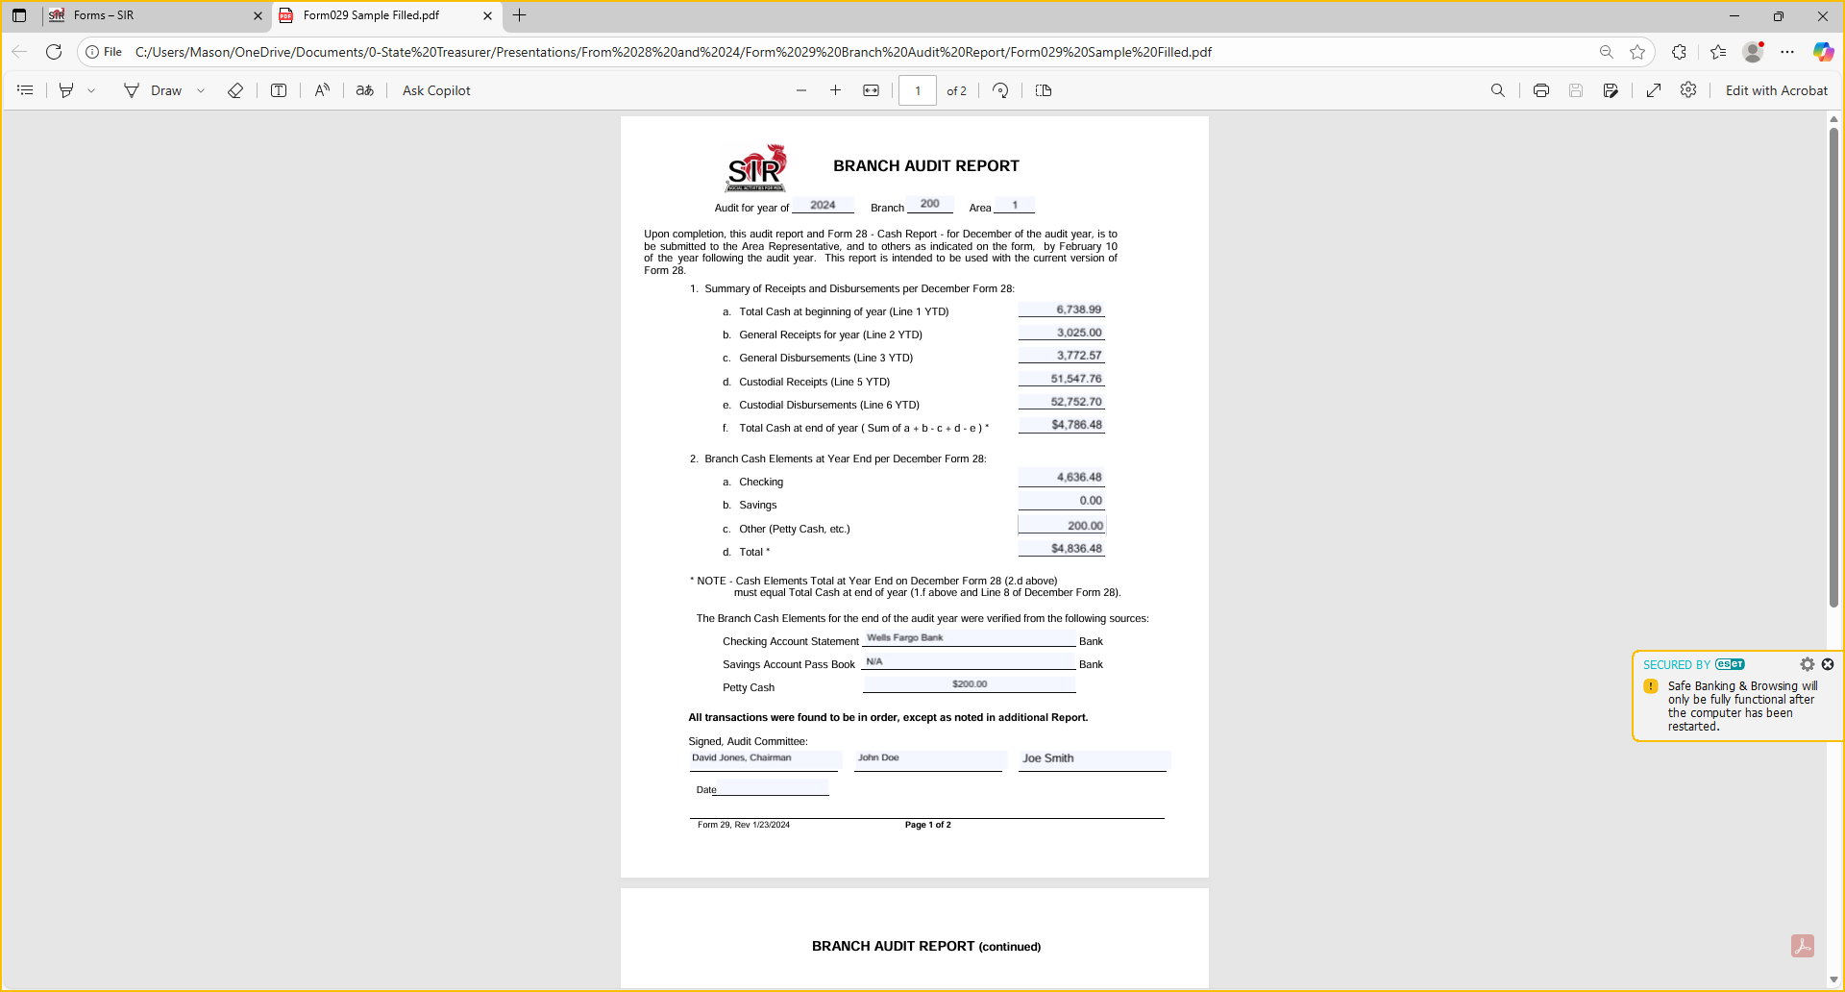
This is a Form 29, First page

Slide 21
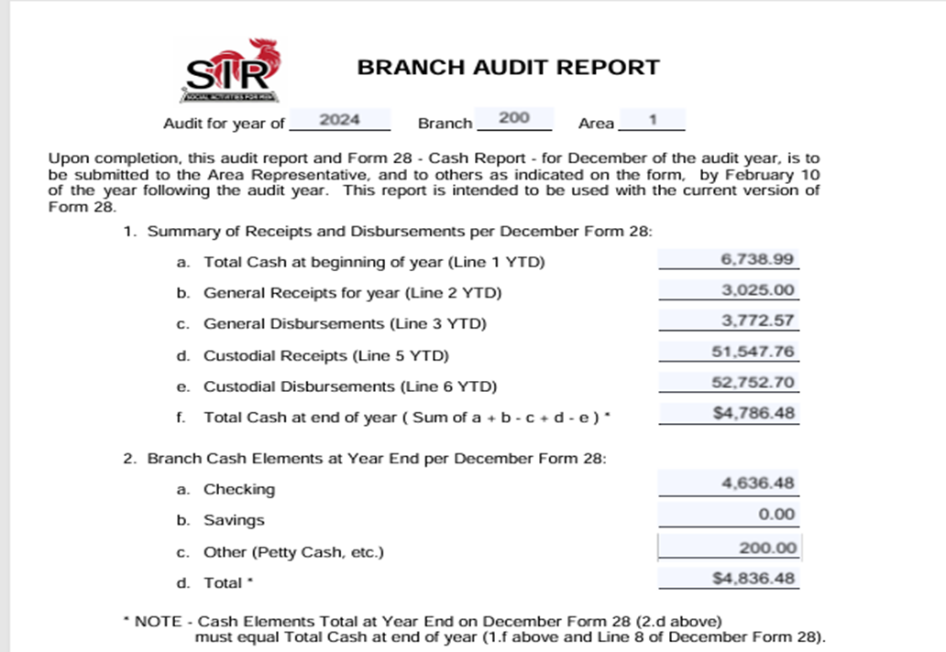

Slide 22
Bottom of First page of Form 29

Slide 23
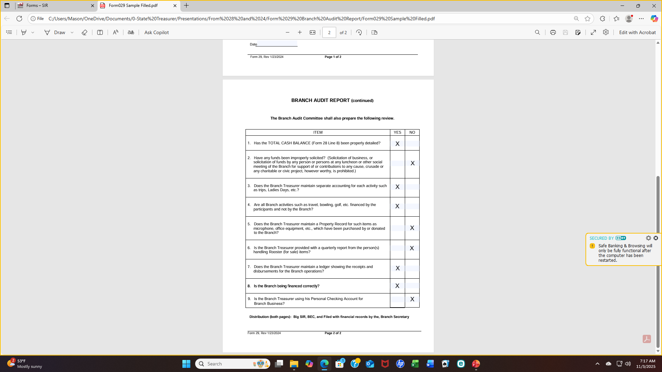
This is a Form 29 Page 2 Compliance Verification

Slide 24
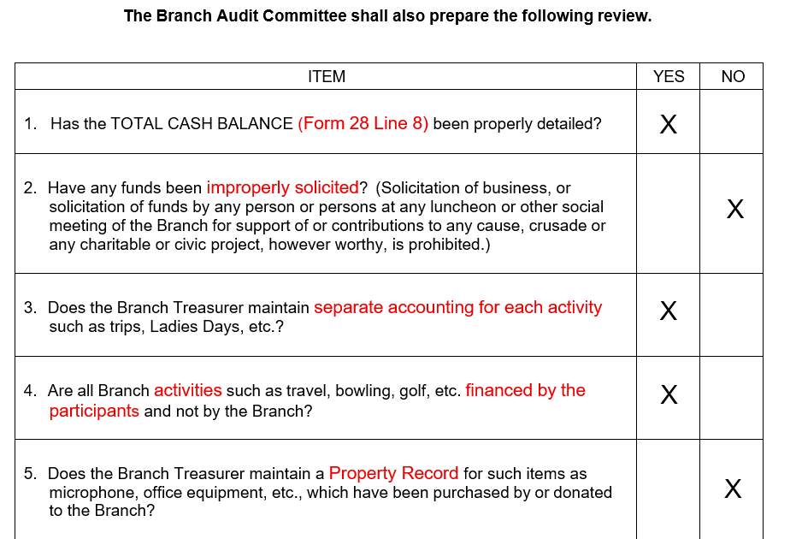

Slide 25
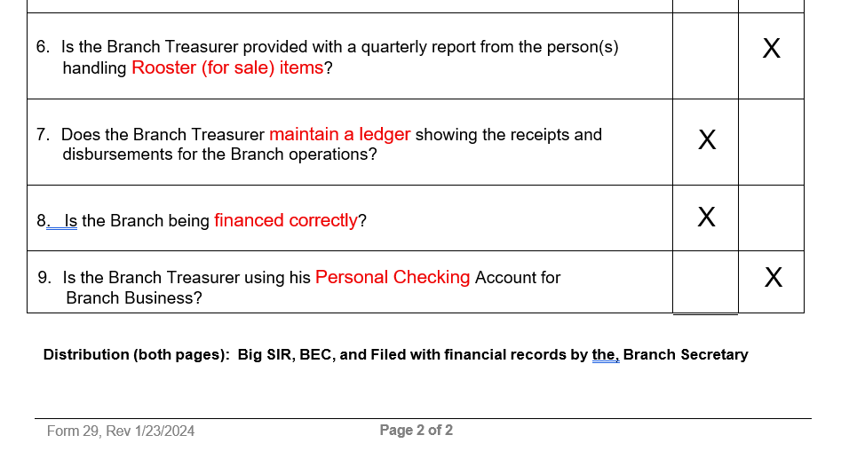

Slide 26
Questions?

